Slide 1


Finding and Keeping
High-Caliber Chauffeurs
and Office Staff
Speakers
John Critchett of Palm Beach Tours & Transportation
Tony Simon of Reston Limousine

Slide 2

How to Find (and Keep)
Talented & Reliable
CHAUFFEURS
&
STAFF

Slide 3
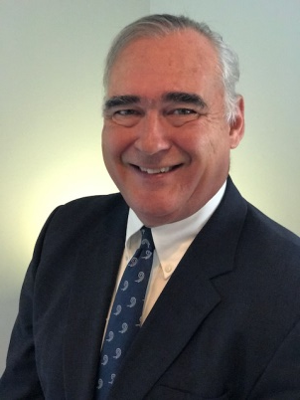
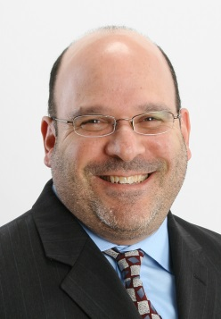

Presenters
John Critchett, President
Palm Beach Tours & Transportation
jcritchett@pbtt.com
Tony Simon, COO
Reston Limousine
tsimon@restonlimo.com

Slide 4
Overview
This session will cover all areas of employee hiring, retention and planning:
Where and How to Find the Best Employees
How Best to Onboard Employees
Employee Retention
When to Add Employees

Slide 5
Where and How to Find the Best Employees
STEP 1: Define and Sell the Position!
Job Description - Detailed but not limiting
Company Description – Who are YOU?
Formatting - Easy to read and follow
Professionalism - Stability
Make it “Pop” - First impression is everything!
(continued)

Slide 6
Where and How to Find the Best Employees
STEP 2: Get it OUT!
Indeed
Glassdoor
Facebook
Craigslist
Employee Referrals-Make is Significant
Radio Ads
(continued)

Slide 7
Where and How to Find the Best Employees
STEP 2: Get it OUT!
Applicant Tracking System (ATS) pushes automatically to:
Regional Workforce Agencies
Beyond Organic
Career Centric Organic
Career Jet
Job Inventory
JobBoost
Jooble
JuJu.com
Monster
Oodle.com
Recruit.net
Regional Help Wanted
SimplyHired
Trovit
US Jobs
Zip Recruiter
(continued)

Slide 8
Where and How to Find the Best Employees
STEP 3: Close the Deal!
Interview
Fast follow-up
Answer all the questions
Get them in ASAP to train

Slide 9
Tools & Strategies to Use
Online Application
Application Database - Someone who isn’t the right fit now may be in the future
Direct Reports - Review resumes and interview the candidate before hiring
Metrics - Record which ad or source attracted the candidate
Personality Types
  Next: How to Best Onboard Employees

Slide 10
How to Best Onboard Employees
Make it EASY - Avoid too much paperwork and redundancy of information
Make it Understandable - Explain the reasons for all the paperwork
Have a Defined Onboarding Plan - Let them know this ahead of time; make them comfortable and already feel like part of the family
(continued)

Slide 11
How to Best Onboard Employees
Training Program
Accessible
Fun
Informative
Feed them good food (this never hurts!)
Meet the Managers & Executives
Over-communicate and reassure
Mentor program
HR follow-up
Next: Employee Retention

Slide 12
Employee Retention
1. Environment
2. Pay & Recognition
3. Growth
4. Management
(continued)

Slide 13
Employee Retention
1. Environment
Provide the tools to succeed
Free stuff (coffee, ties)
Open meetings
Keep them informed about the entire company on a regular basis; Explain all changes
Family functions
Holiday parties: Companywide and by bepartment
(continued)

Slide 14
Employee Retention
2. Pay & Recognition
Bonuses
Annual increases
Awards
Referral programs
“Good Guy” letters to all employees
(continued)

Slide 15
Employee Retention
3. Growth
Job duties
Positions
(continued)

Slide 16
Employee Retention
4. Management
Open Door Policy - No limitation; keep it real but be direct and confirm understanding
Fiduciary responsibility
Be fair and remind them of how you manage
Hold them accountable (they will appreciate it)
Make it personal
Listen
Be open to their suggestions
(continued)

Slide 17
Employee Retention
4. Management
Be proactive: Keep your finger on the pulse
Be flexible
Be empathetic
Inclusive
Annual reviews
Ongoing feedback
(continued)

Slide 18
Employee Retention
4. Management
What to Avoid
        Marginalizing
        Unilateral decisions
        Festering issues
        No follow-up on an issue: After it was handled, ALWAYS confirm that it solved the problem
        Next: When to Add Employees

Slide 19
When to Add Employees
Questions to Ask BEFORE you Add an Employee
Is this the right person to perform these tasks?
Have you completely reviewed the work being performed?
Can others who have extra time handle some of the work?
Can the work be structured to be more efficient through better procedures or implementation of automation tools?
Will this task remain in the ongoing future?
Is this addition necessary for quality of service?
(continued)

Slide 20
When to Add Employees
Questions to Ask BEFORE you Add an Employee
Does everyone involved agree that the addition is necessary? (Important to get buy-in)
How does the extra expense fit within the budget?
What is our growth plan and how does this addition fall into that plan?
(continued)

Slide 21
When to Add Employees
Metrics
        Deadlines
        Quality
        Number of Tasks
Budgets
Forecast
Goals

Slide 22
Conclusion
  “Never hire someone who knows less than you do about what he’s hired to do.”
  -Malcom Forbes

Slide 23

Thank You!
Questions?

Slide 24
Thank you for joining us!
At 2:30 p.m., our Association Summit kicks off in Naples 1-2 while the seminar Leveraging Employee-Focused Leadership Personality Testing will take place in Osceola A.

